Slide 1
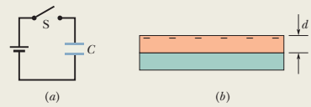
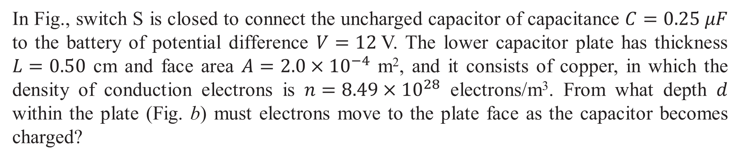
In Fig., switch S is closed to connect the uncharged capacitor of capacitance $C=0.25 μF$ to the battery of potential difference $V=12$V. The lower capacitor plate has thickness $L=0.50$ cm and face area $A={2.0×10}^{−4}$ m², and it consists of copper, in which the density of conduction electrons is $n={8.49×10}^{28}$ electrons/m³. From what depth $d$ within the plate (Fig. b) must electrons move to the plate face as the capacitor becomes charged?

Slide 2
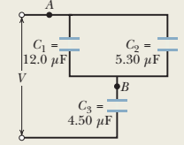
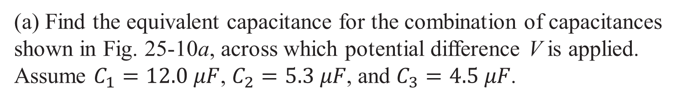
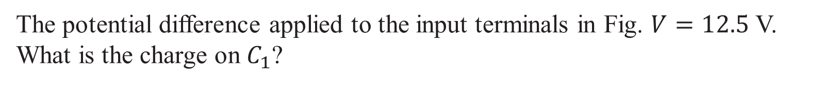
(a) Find the equivalent capacitance for the combination of capacitances shown in Fig. 25-10a, across which potential difference V is applied. Assume $C_{1}=12.0 μF$, $C_{2}=5.3 μF$, and $C_{3}=4.5 μF$.
The potential difference applied to the input terminals in Fig. $V=12.5$ V. What is the charge on $C_{1}$?

Slide 3
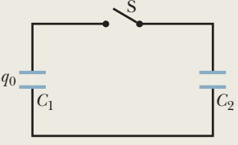
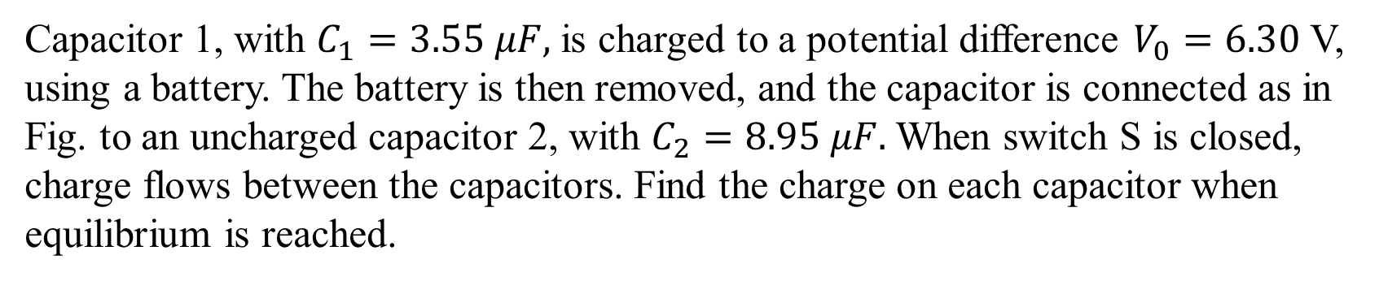
Capacitor 1, with $C_{1}=3.55 μF,$ is charged to a potential difference $V_{0}=6.30$ V, using a battery. The battery is then removed, and the capacitor is connected as in Fig. to an uncharged capacitor 2, with $C_{2}=8.95 μF.$ When switch S is closed, charge flows between the capacitors. Find the charge on each capacitor when equilibrium is reached.

Slide 4
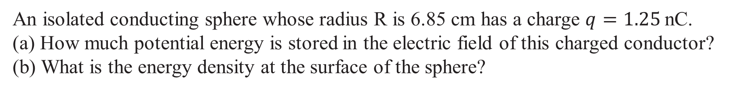
An isolated conducting sphere whose radius R is 6.85 cm has a charge $q=1.25$nC. (a) How much potential energy is stored in the electric field of this charged conductor?
(b) What is the energy density at the surface of the sphere?

Slide 5
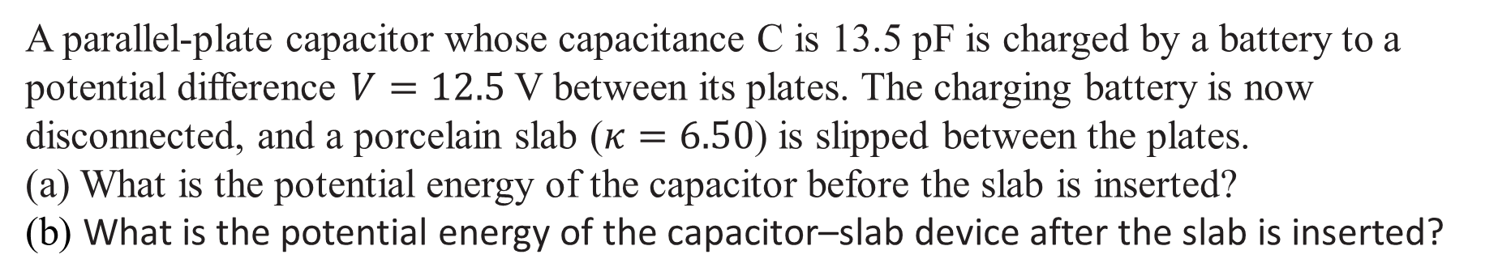
A parallel-plate capacitor whose capacitance C is 13.5 pF is charged by a battery to a potential difference $V=12.5$V between its plates. The charging battery is now disconnected, and a porcelain slab ($κ=6.50$) is slipped between the plates. (a) What is the potential energy of the capacitor before the slab is inserted?
(b) What is the potential energy of the capacitor–slab device after the slab is inserted?

Slide 6
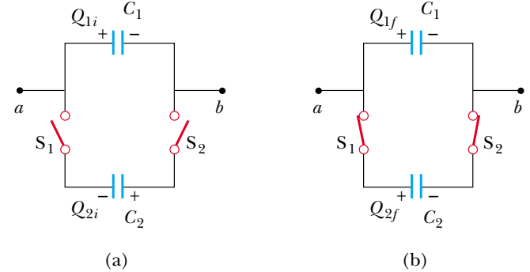
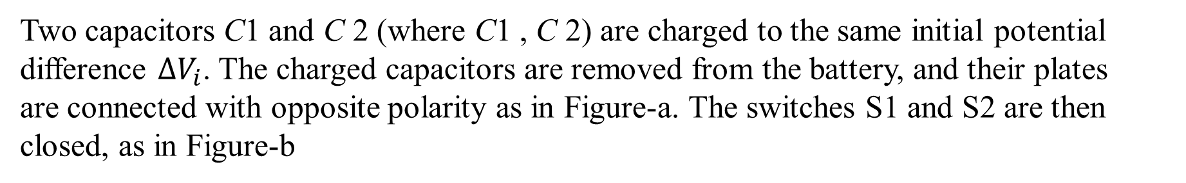
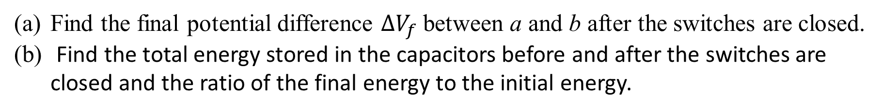
Two capacitors C1 and C 2 (where C1 , C 2) are charged to the same initial potential difference $∆V_{i}$. The charged capacitors are removed from the battery, and their plates are connected with opposite polarity as in Figure-a. The switches S1 and S2 are then closed, as in Figure-b
Find the final potential difference $∆V_{f}$between a and b after the switches are closed.
Find the total energy stored in the capacitors before and after the switches are closed and the ratio of the final energy to the initial energy.

Slide 7
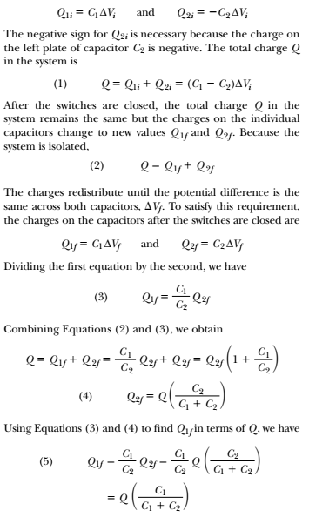
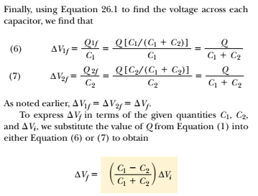

Slide 8
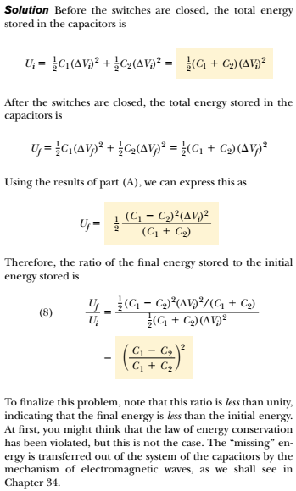

Slide 9
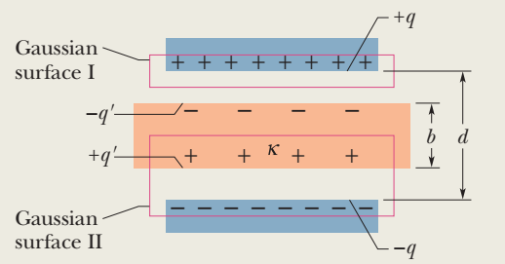
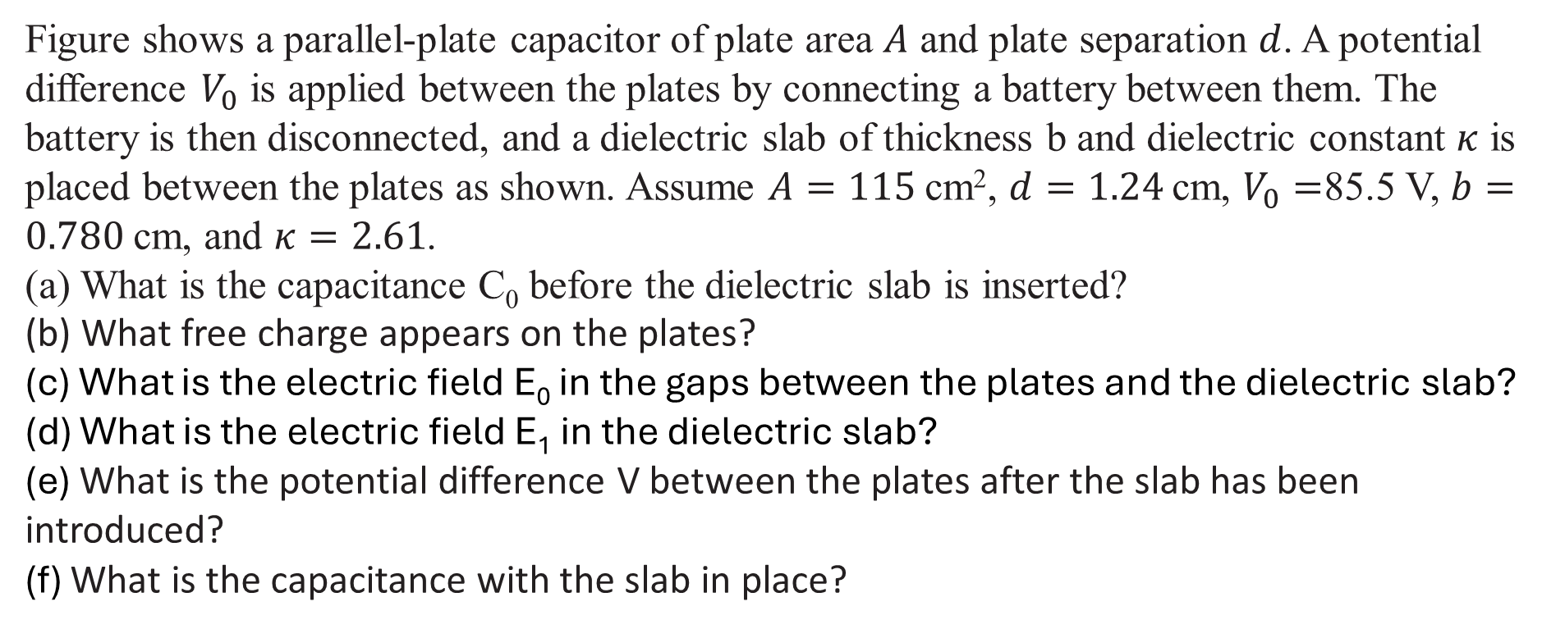
Figure shows a parallel-plate capacitor of plate area $A$ and plate separation $d$. A potential difference $V_{0}$ is applied between the plates by connecting a battery between them. The battery is then disconnected, and a dielectric slab of thickness b and dielectric constant $κ$ is placed between the plates as shown. Assume $A=115$cm², $d=1.24$cm, $V_{0}=$85.5 V, $b=0.780$cm, and $κ=2.61$. (a) What is the capacitance C₀ before the dielectric slab is inserted?
(b) What free charge appears on the plates?
(c) What is the electric field E₀ in the gaps between the plates and the dielectric slab?
(d) What is the electric field E₁ in the dielectric slab?
(e) What is the potential difference V between the plates after the slab has been introduced?
(f) What is the capacitance with the slab in place?

Slide 10
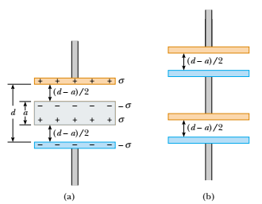
A parallel-plate capacitor has a plate separation d and plate area A. An uncharged metallic slab of thickness a is inserted midway between the plates.
Find the capacitance of the device
Show that the capacitance of the original capacitor is unaffected by the insertion of the metallic slab if the slab is infinitesimally thin.
What if the metallic slab in part (A) is not midway between the plates? How does this affect the capacitance?

Slide 11
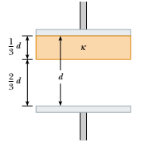
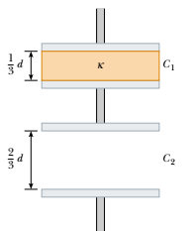
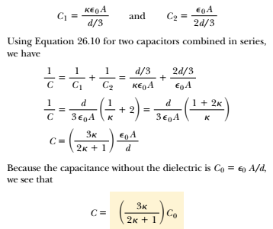
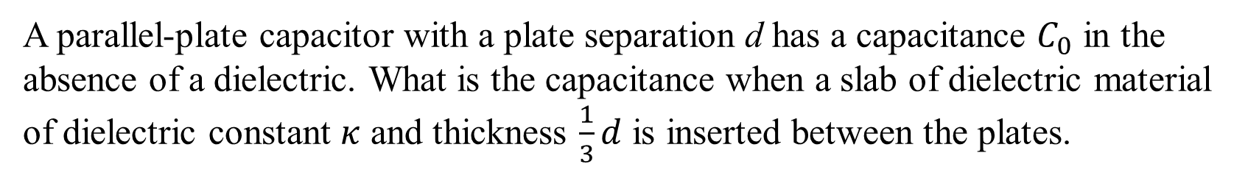
A parallel-plate capacitor with a plate separation d has a capacitance $C_{0}$ in the absence of a dielectric. What is the capacitance when a slab of dielectric material of dielectric constant $κ$ and thickness $\frac{1}{3}d$ is inserted between the plates.

